Slide 1
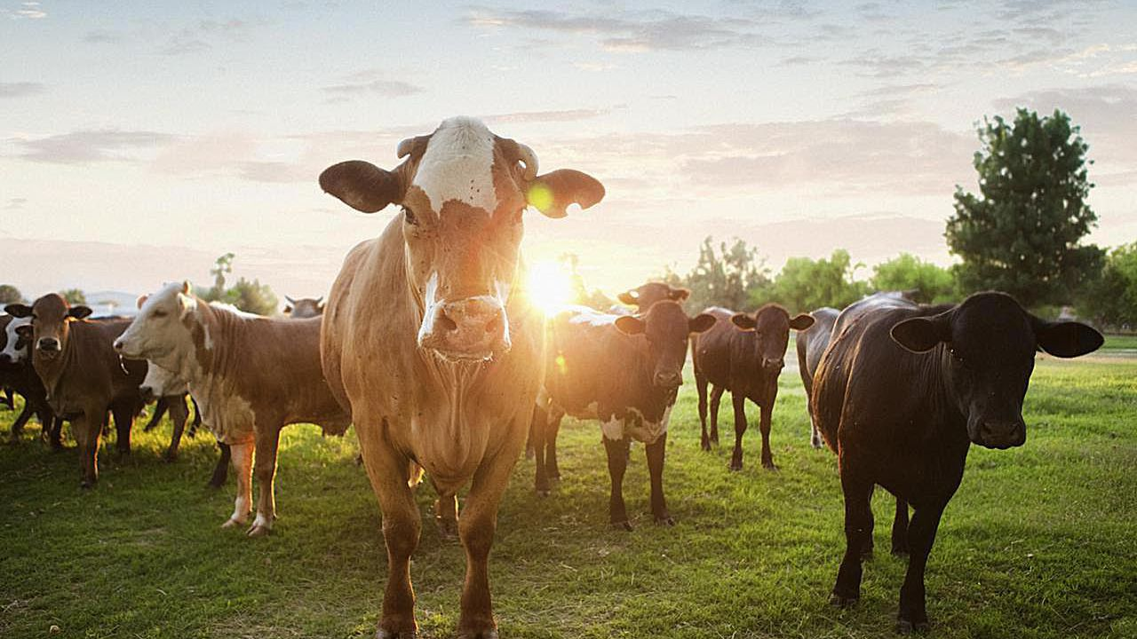
AGING CATTLE USING DENTITION

Slide 2
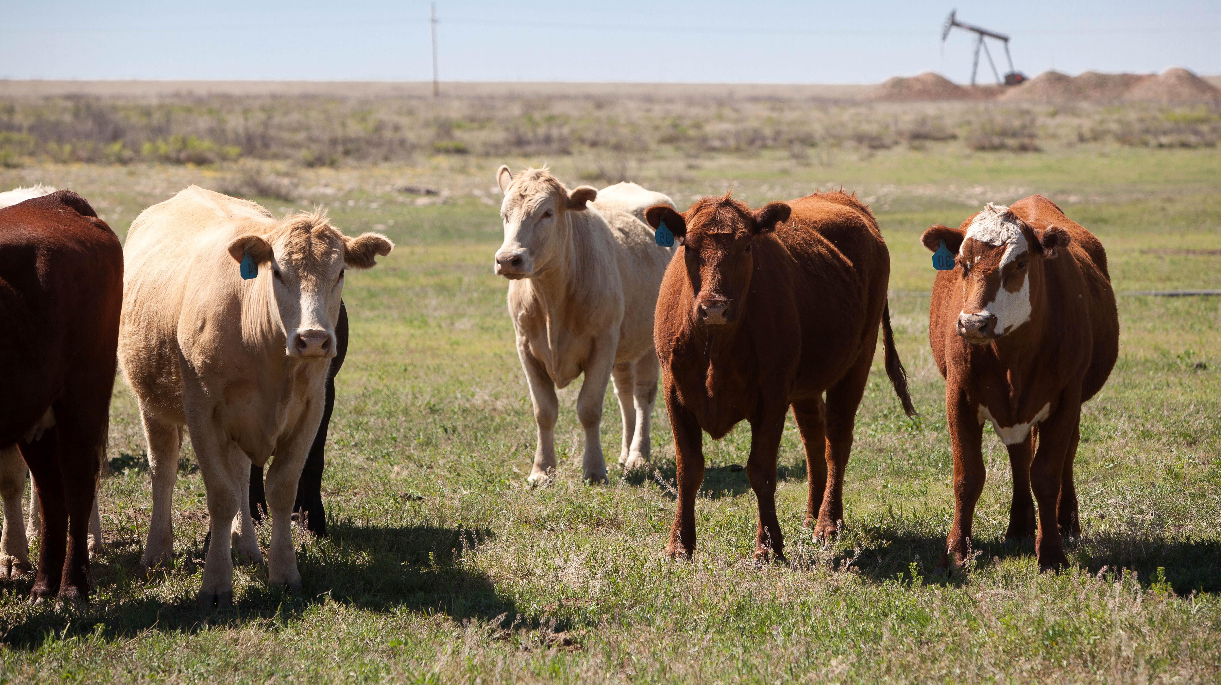
WHY IS IT IMPORTANT?

Slide 3
“Knowing cattle age is useful for both cattle management and marketing. Age affects cattle value. Both replacement and market cows typically decline in value as they age. When possible, cattle birth records should be kept and transferred with the cattle as they move from one operation to another. In this way, the exact ages of animals will be known. When cattle age records are not available, dentition may be used to estimate cattle age. It is common for cattle of unknown age to be “mouthed” by a veterinarian or other trained person to estimate their ages when marketed.” – Mississippi State Extension

Slide 4
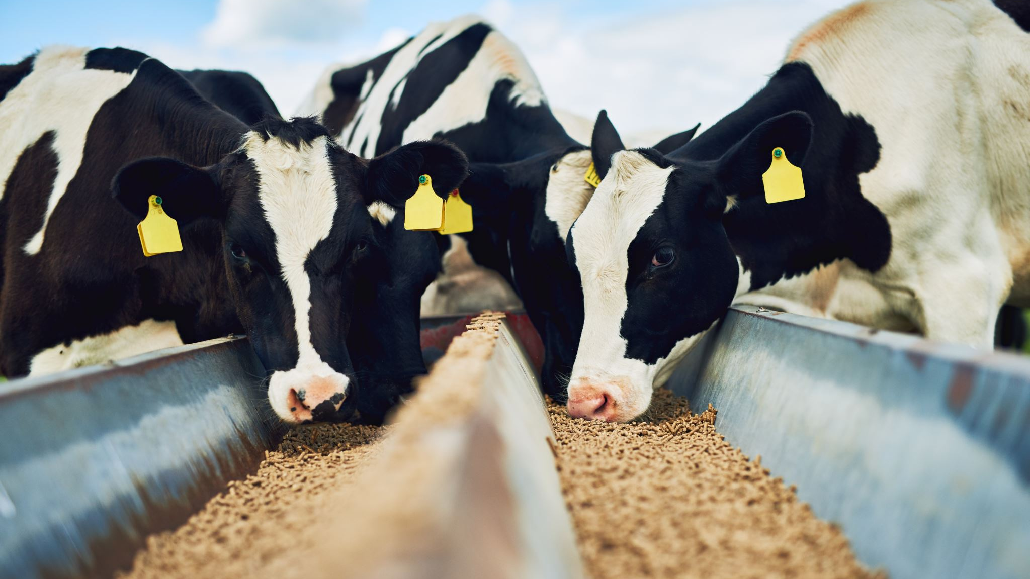
HOW DO WE AGE CATTLE?

Slide 5
DENTAL ANATOMY IN CATTLE
Notes:
Dentition is the development of teeth within the mouth. A schematic of a bovine skull is shown in Figure 1 to depict the locations of the three major teeth types: incisors, premolars, and molars. The incisors appear toward the front of the mouth and only on the bottom jaw of cattle. The front of the upper jaw is a hard dental pad without teeth (see Figure 2). The premolars appear adjacent to the incisors on both sides and back toward the rear of the mouth. Moving farther toward the rear of the mouth, the molars appear adjacent to the premolars. The premolars and molars are collectively known as cheek teeth.

Slide 6
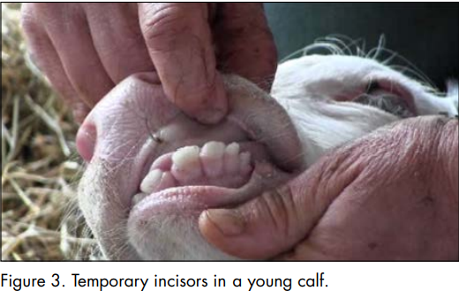
DENTAL ANATOMY IN CATTLE
Cattle first develop 20 temporary teeth, known as deciduous, milk or baby teeth.
They fall out eventually just like ours!
They are much smaller & whiter than permanent teeth
Triangular in appearance

Slide 7
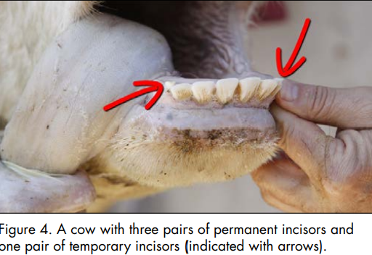
DENTAL ANATOMY IN CATTLE

Slide 8
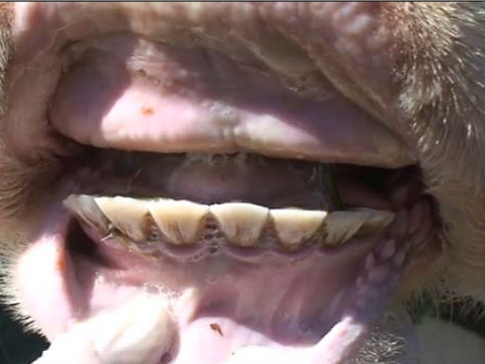
DENTAL ANATOMY IN CATTLE
“The necks of teeth near their bases become narrower as teeth wear. Gaps begin to appear and widen between teeth, and teeth take on a more triangular shape above the gum surface.”
Notes:
With continued wear, their gums being to recede and the root becomes exposed.
With age, cows can lose their teeth or can be broken which we term “broken-mouth”

Slide 9
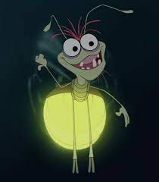
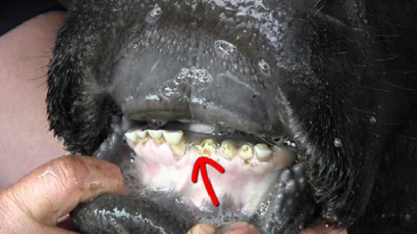
“Broken-Mouth” Cow

Slide 10
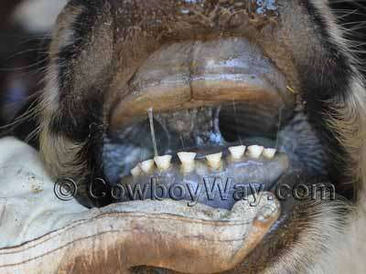
<18 months old

Slide 11
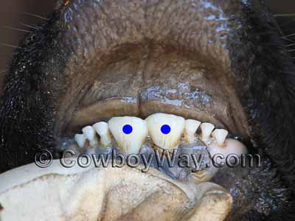
~2 years old

Slide 12
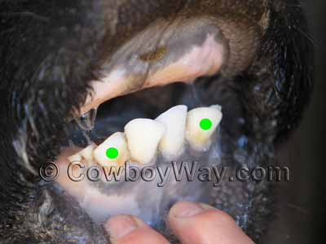
~ 3 years old

Slide 13
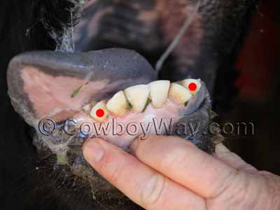
~4 years old

Slide 14
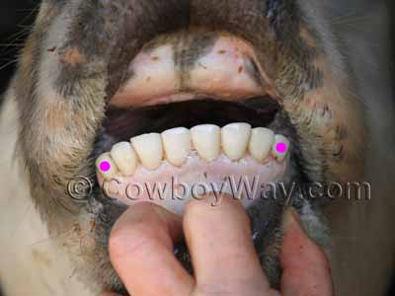
~5 years old

Slide 15
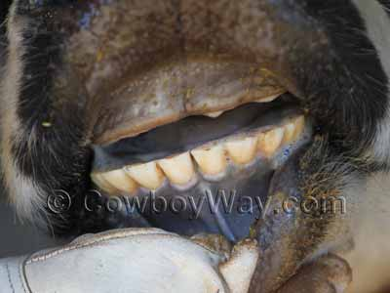
~6 years old
Notes:
At this age, incisors begin to show some wear. The tops of the teeth will still be comparatively sharp but have begun to dull slightly.

Slide 16
QUIZ TIME!

Slide 17
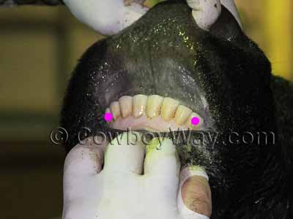
Notes:
5 years old

Slide 18
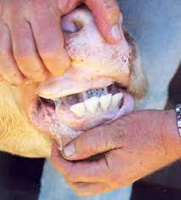
Notes:
3 years old

Slide 19
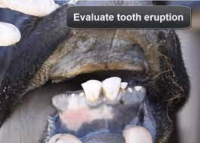
Notes:
2 years old

Slide 20
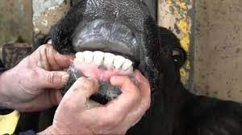
Notes:
4 years old

Slide 21
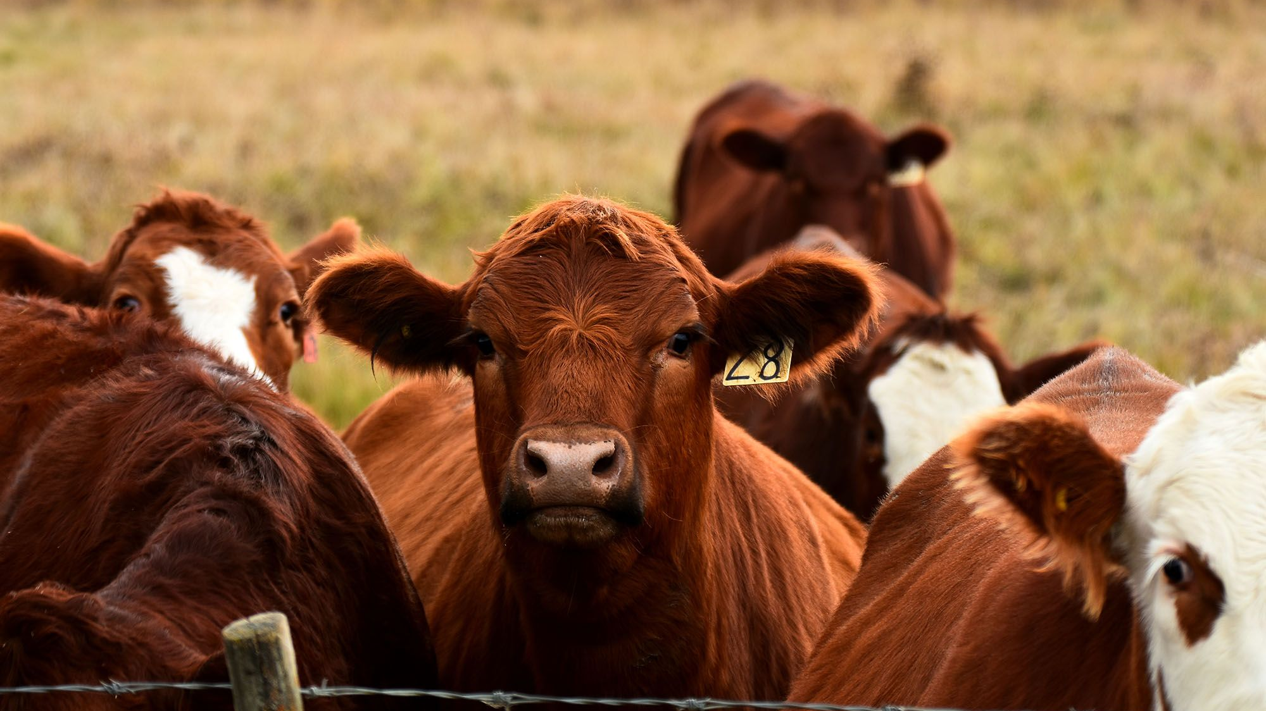
THAT’S ALL FOLKS!
Notes:
References:
MSU Extension – Estimating Cattle Age Using Dentition https://extension.msstate.edu/sites/default/files/publications/publications/p2779.pdf
CowboyWay - http://www.cowboyway.com/HowTo/CowAgeTeeth.htm (pictures)

